Slide 1

I enjoy my work and my life, especially the achievement of work-life balance!
Goals
Complete the challenging tasks in the office where she works.
To take good care of her family.
Frustrations
"Finding changes to pay is so wasting my time.”
“It’s so troublesome to bring lots of money in my wallet.”
Vicky Chen
Age:
Education:
Hometown:
Family:
Occupation:
30
University graduate
Daan, Taipei
Live with her husband and 5-years old daughter
Office lady
Vicky is an office lady who works in a big company. Completing the tasks on time brings her lots of achievement. In addition, she would shop at streetfood stand to buy some materials for cooking, and she has trouble paying by money because it wastes her time a lot.

Slide 2
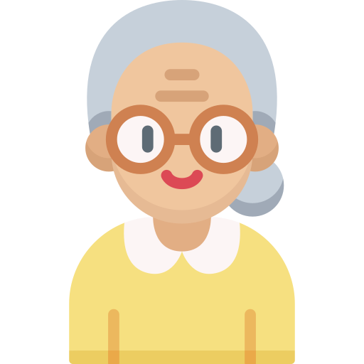
I really enjoy the time after retirement and accompany with my husband!
Goals
To find an interesting course to take in the community.
To have a short-term travel with her husband.
Frustrations
"It’s so difficult to remember every deal at street food stand when buying.”
“Sometimes, I have trouble tidying up invoice I have collected. “
Susan Wang
Age:
Education:
Hometown:
Family:
Occupation:
65
High school graduate
Beitou, Taipei
Live with her husband
Retirement
Susan enjoys her retirement life a lot. She plans to take some interesting courses in the community and travel with her husband. However, she have some problems when buying some food on the streetfood stands.

